Slide 1
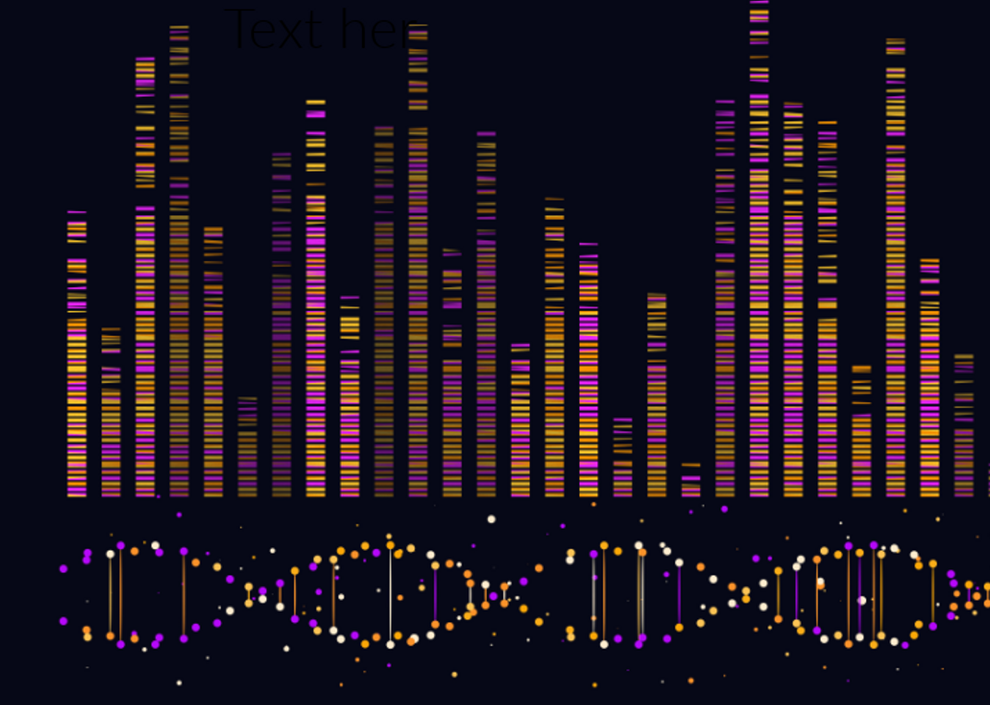
Genetic Algorithm
Tristan Burns
42648493

Slide 2
1
1
1
1
1
1

Slide 3
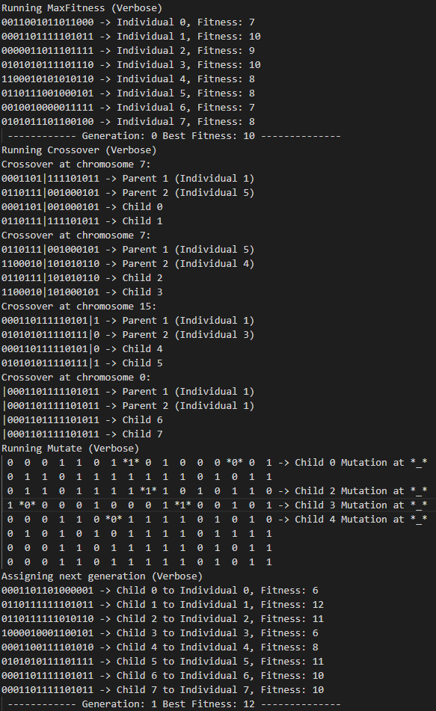

Slide 9
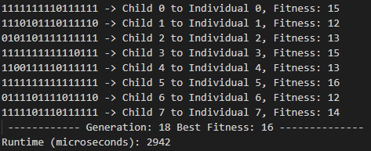

Slide 10
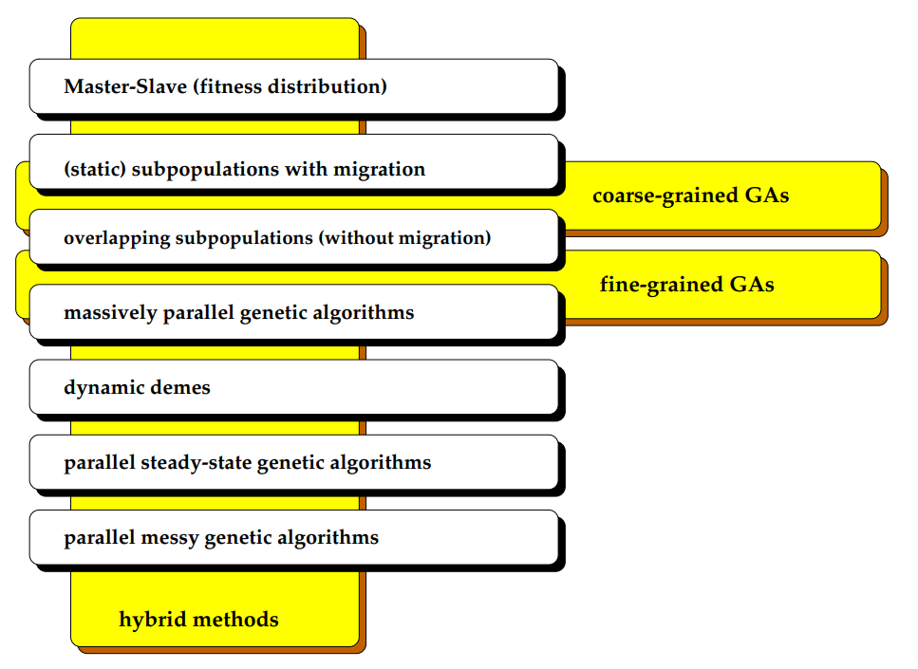

Slide 11


Slide 12


Slide 13


3
0
1
0
1
2
0
1
0
1
2
3
2
3
2
3
(a)
(b)
(c)

Slide 14
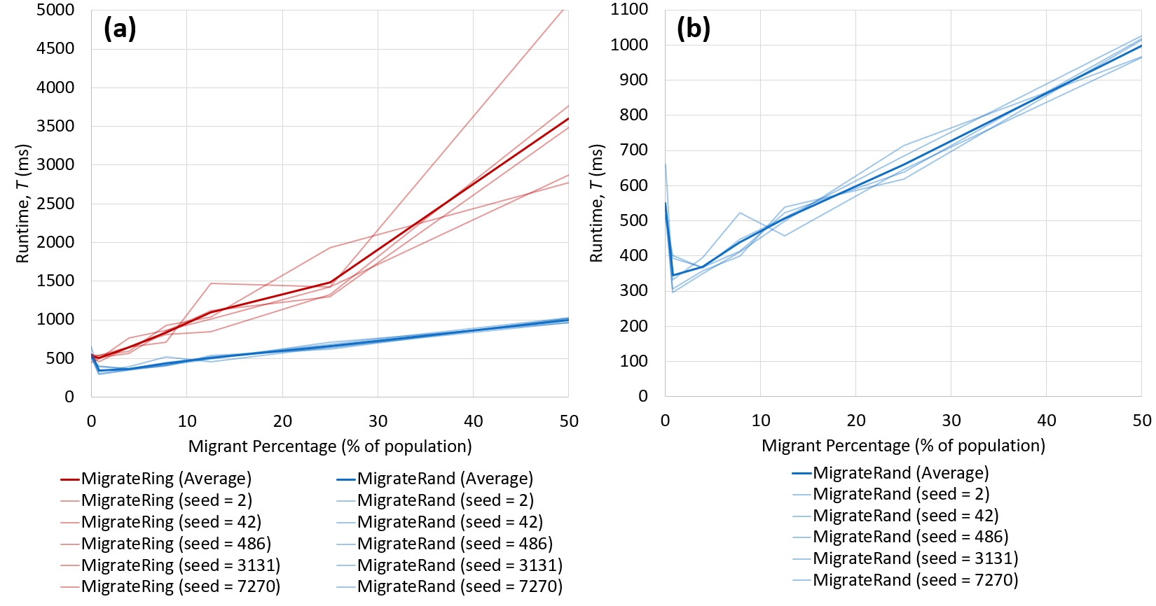

Slide 15
No. of Islands, k (No. MPI Ranks) | Chromosome Sizes, n | Seeds | Migration Type | No. of Migrants | Population Size, m
1 (Serial) | 16, 32, 64, 128, 256, 512, 2048, 4096, 8192, 16384, 32768 | 2, 42, 486, 3131, 7270 | Rand* | 1* | 128
1 (Serial) | 16, 32, 64, 128, 256, 512, 2048, 4096, 8192, 16384, 32768 | 2, 42, 486, 3131, 7270 | Rand* | 1* | 128
1 (Serial) | 16, 32, 64, 128, 256, 512, 2048, 4096, 8192, 16384, 32768 | 2, 42, 486, 3131, 7270 | Rand* | 1* | 128
1 (Serial) | 16, 32, 64, 128, 256, 512, 2048, 4096, 8192, 16384, 32768 | 2, 42, 486, 3131, 7270 | Rand* | 1* | 128
1 (Serial) | 16, 32, 64, 128, 256, 512, 2048, 4096, 8192, 16384, 32768 | 2, 42, 486, 3131, 7270 | Rand* | 1* | 128
1 (Serial) | 16, 32, 64, 128, 256, 512, 2048, 4096, 8192, 16384, 32768 | 2, 42, 486, 3131, 7270 | Rand* | 1* | 128
1 (Serial) | 16, 32, 64, 128, 256, 512, 2048, 4096, 8192, 16384, 32768 | 2, 42, 486, 3131, 7270 | Rand* | 1* | 128
1 (Serial) | 16, 32, 64, 128, 256, 512, 2048, 4096, 8192, 16384, 32768 | 2, 42, 486, 3131, 7270 | Rand* | 1* | 128
1 (Serial) | 16, 32, 64, 128, 256, 512, 2048, 4096, 8192, 16384, 32768 | 2, 42, 486, 3131, 7270 | Rand* | 1* | 128
1 (Serial) | 16, 32, 64, 128, 256, 512, 2048, 4096, 8192, 16384, 32768 | 2, 42, 486, 3131, 7270 | Rand* | 1* | 128
1 (Serial) | 16, 32, 64, 128, 256, 512, 2048, 4096, 8192, 16384, 32768 | 2, 42, 486, 3131, 7270 | Rand* | 1* | 128
1 (Serial) | 16, 32, 64, 128, 256, 512, 2048, 4096, 8192, 16384, 32768 | 2, 42, 486, 3131, 7270 | Rand* | 1* | 128
4 | 16, 32, 64, 128, 256, 512, 2048, 4096, 8192, 16384, 32768 | 2, 42, 486, 3131, 7270 | Rand* | 1* | 128
4 | 16, 32, 64, 128, 256, 512, 2048, 4096, 8192, 16384, 32768 | 2, 42, 486, 3131, 7270 | Rand* | 1* | 128
4 | 16, 32, 64, 128, 256, 512, 2048, 4096, 8192, 16384, 32768 | 2, 42, 486, 3131, 7270 | Rand* | 1* | 128
4 | 16, 32, 64, 128, 256, 512, 2048, 4096, 8192, 16384, 32768 | 2, 42, 486, 3131, 7270 | Rand* | 1* | 128
4 | 16, 32, 64, 128, 256, 512, 2048, 4096, 8192, 16384, 32768 | 2, 42, 486, 3131, 7270 | Rand* | 1* | 128
4 | 16, 32, 64, 128, 256, 512, 2048, 4096, 8192, 16384, 32768 | 2, 42, 486, 3131, 7270 | Rand* | 1* | 128
4 | 16, 32, 64, 128, 256, 512, 2048, 4096, 8192, 16384, 32768 | 2, 42, 486, 3131, 7270 | Rand* | 1* | 128
4 | 16, 32, 64, 128, 256, 512, 2048, 4096, 8192, 16384, 32768 | 2, 42, 486, 3131, 7270 | Rand* | 1* | 128
4 | 16, 32, 64, 128, 256, 512, 2048, 4096, 8192, 16384, 32768 | 2, 42, 486, 3131, 7270 | Rand* | 1* | 128
4 | 16, 32, 64, 128, 256, 512, 2048, 4096, 8192, 16384, 32768 | 2, 42, 486, 3131, 7270 | Rand* | 1* | 128
4 | 16, 32, 64, 128, 256, 512, 2048, 4096, 8192, 16384, 32768 | 2, 42, 486, 3131, 7270 | Rand* | 1* | 128
4 | 16, 32, 64, 128, 256, 512, 2048, 4096, 8192, 16384, 32768 | 2, 42, 486, 3131, 7270 | Rand* | 1* | 128
8 | 16, 32, 64, 128, 256, 512, 2048, 4096, 8192, 16384, 32768 | 2, 42, 486, 3131, 7270 | Rand* | 1* | 128
8 | 16, 32, 64, 128, 256, 512, 2048, 4096, 8192, 16384, 32768 | 2, 42, 486, 3131, 7270 | Rand* | 1* | 128
8 | 16, 32, 64, 128, 256, 512, 2048, 4096, 8192, 16384, 32768 | 2, 42, 486, 3131, 7270 | Rand* | 1* | 128
8 | 16, 32, 64, 128, 256, 512, 2048, 4096, 8192, 16384, 32768 | 2, 42, 486, 3131, 7270 | Rand* | 1* | 128
8 | 16, 32, 64, 128, 256, 512, 2048, 4096, 8192, 16384, 32768 | 2, 42, 486, 3131, 7270 | Rand* | 1* | 128
8 | 16, 32, 64, 128, 256, 512, 2048, 4096, 8192, 16384, 32768 | 2, 42, 486, 3131, 7270 | Rand* | 1* | 128
8 | 16, 32, 64, 128, 256, 512, 2048, 4096, 8192, 16384, 32768 | 2, 42, 486, 3131, 7270 | Rand* | 1* | 128
8 | 16, 32, 64, 128, 256, 512, 2048, 4096, 8192, 16384, 32768 | 2, 42, 486, 3131, 7270 | Rand* | 1* | 128
8 | 16, 32, 64, 128, 256, 512, 2048, 4096, 8192, 16384, 32768 | 2, 42, 486, 3131, 7270 | Rand* | 1* | 128
8 | 16, 32, 64, 128, 256, 512, 2048, 4096, 8192, 16384, 32768 | 2, 42, 486, 3131, 7270 | Rand* | 1* | 128
8 | 16, 32, 64, 128, 256, 512, 2048, 4096, 8192, 16384, 32768 | 2, 42, 486, 3131, 7270 | Rand* | 1* | 128
8 | 16, 32, 64, 128, 256, 512, 2048, 4096, 8192, 16384, 32768 | 2, 42, 486, 3131, 7270 | Rand* | 1* | 128
16 | 16, 32, 64, 128, 256, 512, 2048, 4096, 8192, 16384, 32768 | 2, 42, 486, 3131, 7270 | Rand* | 1* | 128
16 | 16, 32, 64, 128, 256, 512, 2048, 4096, 8192, 16384, 32768 | 2, 42, 486, 3131, 7270 | Rand* | 1* | 128
16 | 16, 32, 64, 128, 256, 512, 2048, 4096, 8192, 16384, 32768 | 2, 42, 486, 3131, 7270 | Rand* | 1* | 128
16 | 16, 32, 64, 128, 256, 512, 2048, 4096, 8192, 16384, 32768 | 2, 42, 486, 3131, 7270 | Rand* | 1* | 128
16 | 16, 32, 64, 128, 256, 512, 2048, 4096, 8192, 16384, 32768 | 2, 42, 486, 3131, 7270 | Rand* | 1* | 128
16 | 16, 32, 64, 128, 256, 512, 2048, 4096, 8192, 16384, 32768 | 2, 42, 486, 3131, 7270 | Rand* | 1* | 128
16 | 16, 32, 64, 128, 256, 512, 2048, 4096, 8192, 16384, 32768 | 2, 42, 486, 3131, 7270 | Rand* | 1* | 128
16 | 16, 32, 64, 128, 256, 512, 2048, 4096, 8192, 16384, 32768 | 2, 42, 486, 3131, 7270 | Rand* | 1* | 128
16 | 16, 32, 64, 128, 256, 512, 2048, 4096, 8192, 16384, 32768 | 2, 42, 486, 3131, 7270 | Rand* | 1* | 128
16 | 16, 32, 64, 128, 256, 512, 2048, 4096, 8192, 16384, 32768 | 2, 42, 486, 3131, 7270 | Rand* | 1* | 128
16 | 16, 32, 64, 128, 256, 512, 2048, 4096, 8192, 16384, 32768 | 2, 42, 486, 3131, 7270 | Rand* | 1* | 128
16 | 16, 32, 64, 128, 256, 512, 2048, 4096, 8192, 16384, 32768 | 2, 42, 486, 3131, 7270 | Rand* | 1* | 128

Slide 16
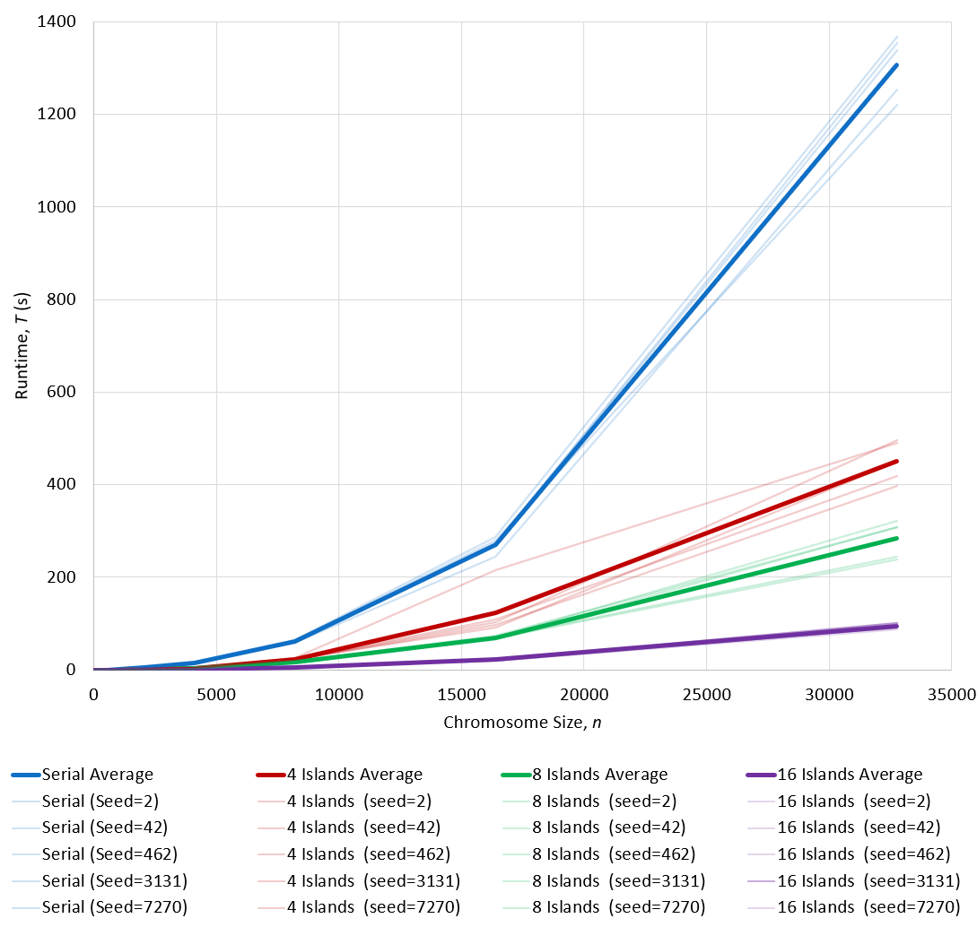

Slide 17
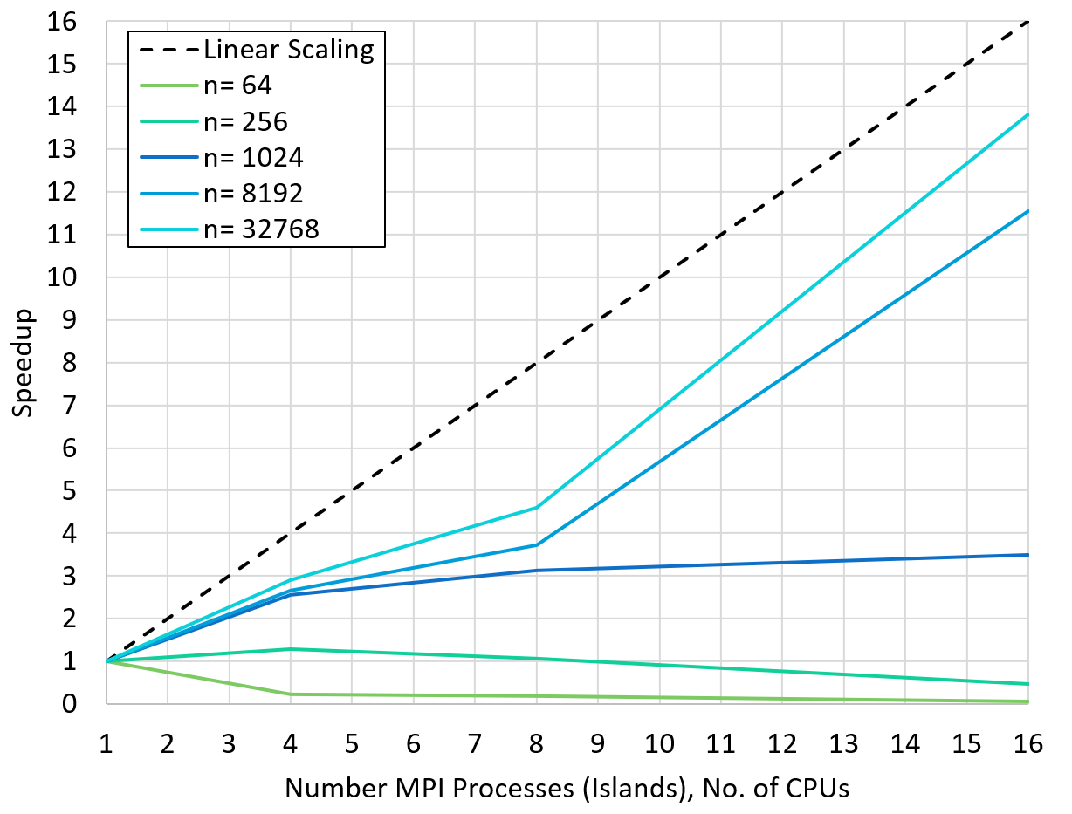

Slide 18
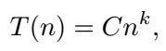

Slide 19
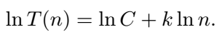

Slide 20
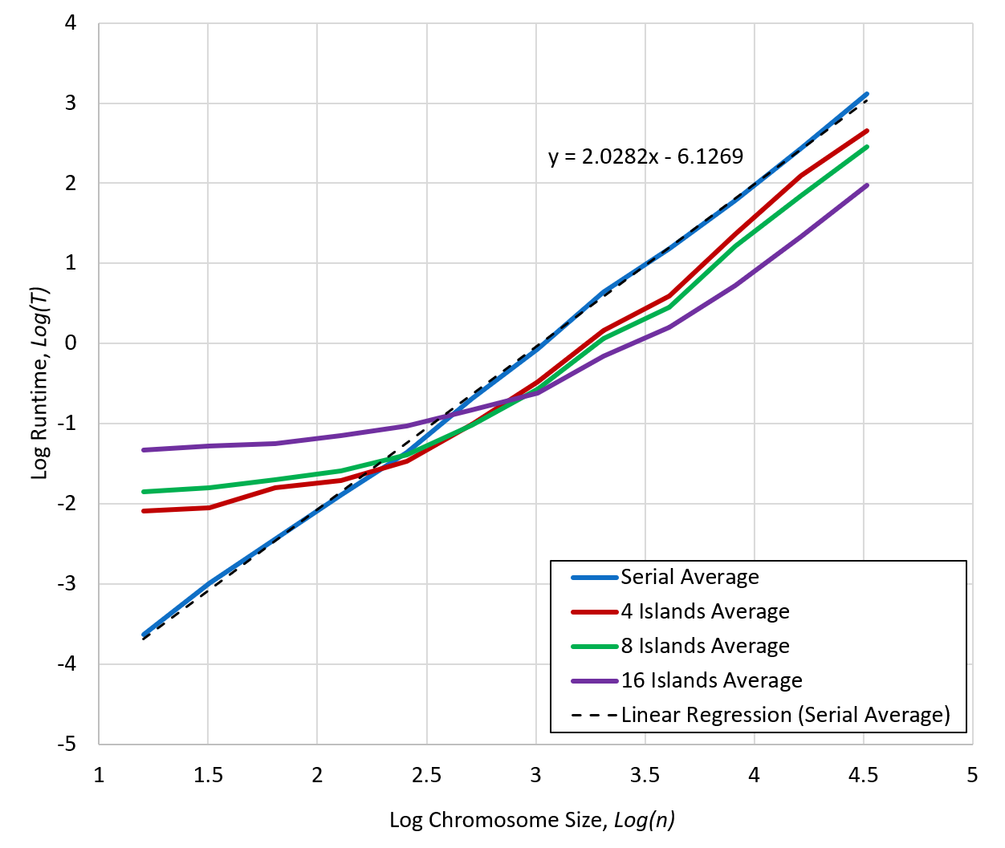

Slide 21
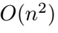

Slide 22

Thanks for the Semester

